Slide 1
Beta Brotherhood Assessment
Chapter Report Overview

Slide 2
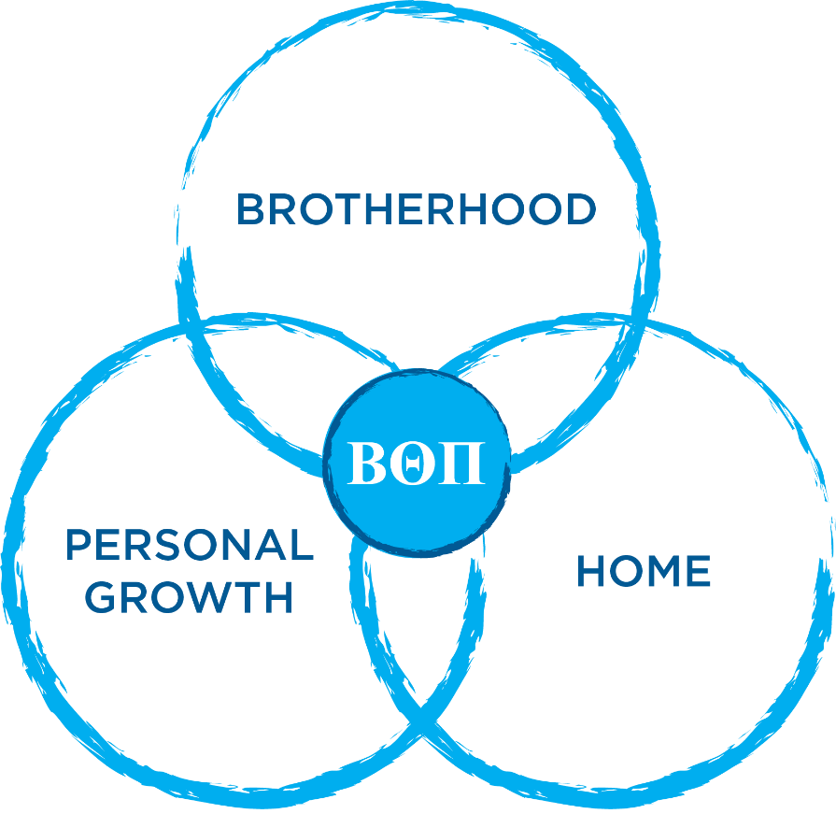
Strategic Initiatives
Beta Theta Pi Fraternity
SIX STRATEGIC INITIATIVES
Cultural Assessment
Volunteer Engagement
Housing Standards
Risk Management Education
Member Education
Interfraternal Partnerships

Slide 4
Assessment Response Rate
136
80%
45+
Chapters
Organizational Response Rate
Chapters with 100% response rate

Slide 5
The Chapter Report

Slide 6
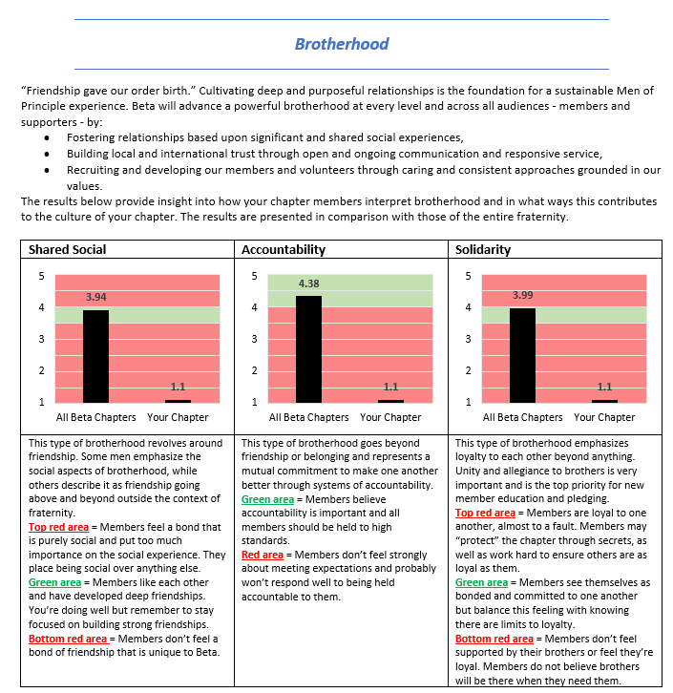
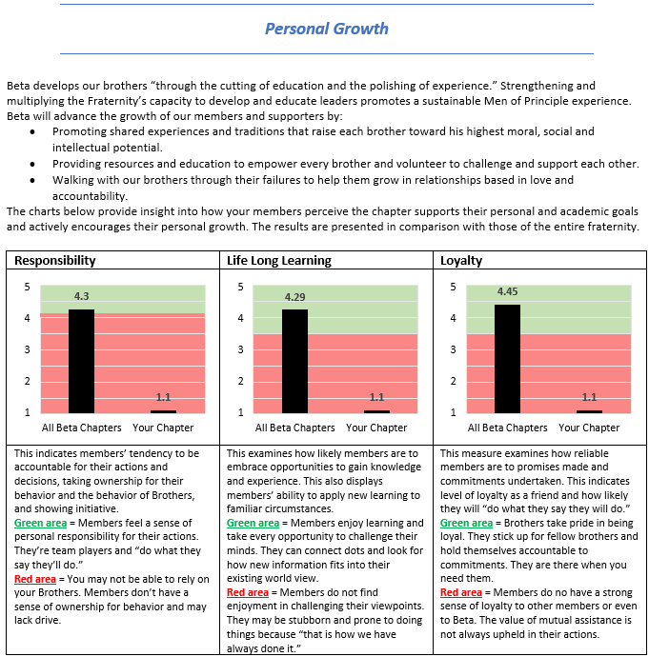
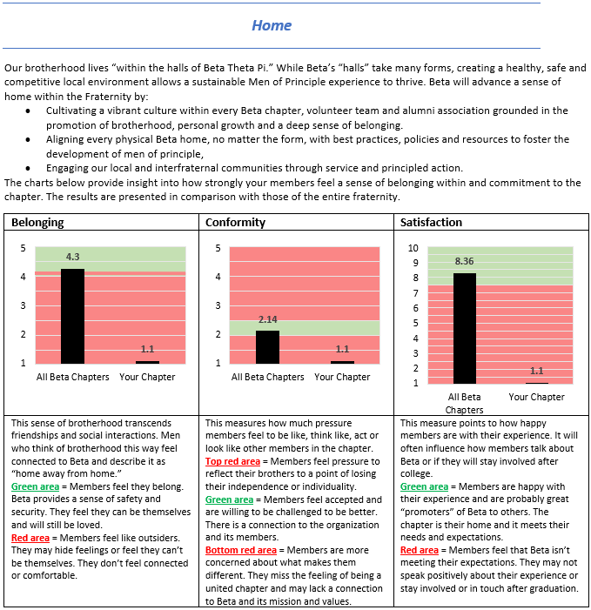
The Chapter Report

Slide 7
4 unique definitions of brotherhood
Brotherhood Based on Solidarity
Brotherhood Based on Shared Social Experiences
Brotherhood Based on Belonging
Brotherhood Based on Accountability

Slide 8
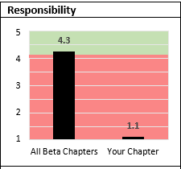
The Chapter Report

Slide 9
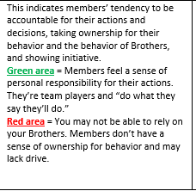
The Chapter Report

Slide 10
The Chapter Report

Slide 11
Discussion Questions
What are some of your thoughts coming out of your discussions?
What surprised you about our chapter based on the data in the report?
What surprised you about Beta overall based on the data in the report?
What is the area that you think we should focus our efforts on improving working on?

Slide 12
Discussion Questions
Where should the executive team members, and the membership overall look to focus in the coming year.

Slide 13
Beta Brotherhood Assessment
Chapter Report Overview
Notes:
..

